Slide 1
Game Distribution
Ethan Mabey, Brannon Lai, George Huang, Ruby Jacobsen, Elan Horne

Slide 2
Types Ethan Mabey
Physical
Disk or game cartridge
Digital
Downloaded from Steam or GitHub
Streaming Services
Playing online via Xbox Cloud
App Store
Apple App store or Google Play store
Microsoft Store
Cross platform with Xbox and various devices

Slide 3
Physical Media
Brannon Lai
Typically includes most console games such as Xbox, Playstation, and Nintendo. Players must travel to their local game stores (GameStop, etc) in order to purchase the game or order a copy online.
Benefits:
Collectible/resale value
Stored in real life rather than in the console
Satisfying to have the ability to hold, kiss, throw etc your game however you wish
Drawbacks:
Can get lost/damaged
Take up space
Require going outside
Older games are typically marked up for a significant price hike
Cost of putting the game inside a disk is high for the company

Slide 4

Digital Downloads
Ruby Jacobsen
Steam
Epic Games
Itch.io
-Game update automation.
-Cloud storage.
-Community features.
-Quick access.
-Supports windows, linux, mac, ios, etc.
-Good for small and independent developers.
-Developers can set a minimum price for the game but customers can choose to pay extra.
-Know to have many bugs and run slow.
-Lacks community features.
-Not trustworthy with consumers data.
-Considered to be a monopoly.
-Difficult for independent developers.
-Bad market visibility.
-Limited features.

Slide 5
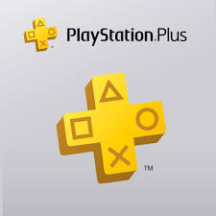
Streaming Services George H
Characteristics:
Cloud-Based infrastructure
Multi-Device Compatibility
Subscription or Pay-Per-Use Models
Streaming Quality
Library of Games
Examples:
Google Stadia
Xbox Cloud Gaming
GeForce NOW
Playstation Plus
Amazon Luna
Benefits:
No need for high-end hardware
Portability
Cost Efficiency
Access to large libraries
Drawbacks:
Internet Dependency
Latency
Data Usage
Regional Availability

Slide 6

Apple
Elan Horne
Pros:
Apple only allows for top quality apps to pass and be able to play.
Allow for Mobile Games
It allows IOS
You get
17% commission
3% of payments
10% if you are enrolled in the small business program or the video partner program
Apple takes 15-30% of subscriptions you get the rest.
Cons:
It Costs to put your game on apple
To publish a game on Apple apple store you need to have the Apple developer Program which is $99.
Then they take 30% of commission rate of the purchases made on the App store
They also take 15% for substrictions
Higher chance of being rejected

Slide 7
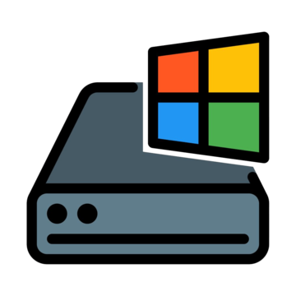
Microsoft
Elan Horne
Ruby Jacobsen
Pros:
Secure and trustworthy
Reach and visibility
Allows a large audience who can discover your work,
Revenue
Only take 12-15% of the revenue.
Compatible and flexible
Can work across different devices.
Easy use
Designed to be user-friendly.
Cons:
Some Xbox purchases will split it 70%-30% or if you use the competitive fee it is 12%
Microsoft has apparently been corrupted
Limited functionality and applications
Poor Performance compared to other applications
You only get to keep 100% and choose your own Commerce platform if you have a non-gaming app

Slide 8


Conclusion
We all came to the conclusion that we would most likely just do a digital download, as it would be easy to do. We could just have a public Github repo or an application on steam or on a site like Game Jolt, similar to Undertale Yellow.

